Slide 1
Input and Output Statements

Slide 2
Input()--- In-built function
In Python, to read input from the user, we have an in-built function called input().
The syntax for input() function is :
input([prompt])
Here, the optional prompt string will be printed to the console for the user to input a value.
The prompt string is used to indicate the type of value to be entered by the user.

Slide 3
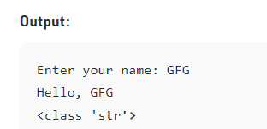
# Taking input from the user
name = input("Enter your name: ")
# for Output
print("Hello, " + name)
print(type(name))

Slide 4
Write a program to print your favourite place.
At the time of execution, the program should print the message on the console as:
Enter your favourite place:
For example, if the user gives the input as:
Enter your favourite place: Hyderabad
then the program should print the result as:
My favourite place is: Hyderabad

Slide 5
Using the print() output function
In Python, the print function is the first and the most basic output function one can use. It is used to generate an output at the console. Syntax of print() function -
We can pass zero or more number of expressions separated by commas(,) to print() function.

Slide 6
The print() function converts those expressions into strings and writes the result to standard output which then displays the result on screen.
Let us consider an example of print() with multiple values with comma(,) as separator.
Example 1:
print("Hi", "Hello", "Python") # will print output as follows
Hi Hello Python

Slide 7
Example 2:
a = 10
b = 50
print("A value is", a, "and", "B value is", b) # will print output as follows
A value is 10 and B value is 50
Here we have assigned values 10 and 50 to a and b respectively.
The above print() statement consists of both strings and integer values.

Slide 8
Write a program to print your favourite programming language.
At the time of execution, the program should print the message on the console as:
Enter Language:
# For example, if the user gives the input as:
Enter Language: Python
#then the program should print the result as:
# Expected Output
My Favourite Language is Python

Slide 9
The print() function is used to print the values to the standard output.
The general syntax of print() function is:
print(value1, value2..., sep = ' ', end = '\n', file = sys.stdout, flush = False)
where,
-> value1,value2...,valuen These are the actual data values to printed.
-> sep This is the separator used between each value. If there is no separator, then by default 'whitespace' is taken.
end This is the character which gets printed after all values have been printed. The newline character '\n' is the default.
file This argument specifies where the output needs to be printed. The screen is the standard output by default

Slide 10
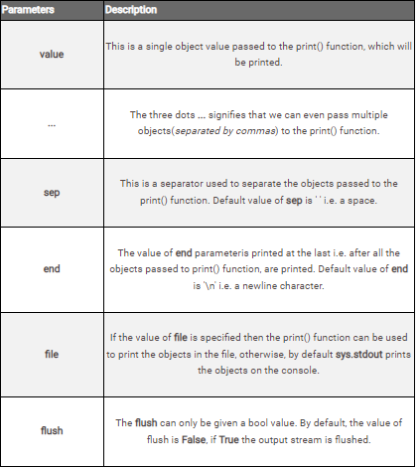

Slide 11
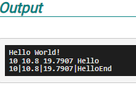
Let us show you a few examples of different variations of calling the print() function. # Python - The print() function
i = 10
f = 10.8
d = 19.7907
str1 = 'Hello'
# Passing a single object to be printed to the print() function
print('Hello World!')
# Passing multiple objects to be printed to the print() function
print(i, f, d, str1)
# Passing multiple objects to be printed to the print() function
# And, also passing it arguments to alter with its default behaviour
print(i, f, d, str1, sep='|', end='End')

Slide 12
Program Analysis
As you can see in the first call of print() function, we have simply passed it string object.
In the second call of print() function, we have simply passed it 4 objects and it has printed their value(by default, they are separated by spaces).
In the third call of the print() function, we have not just passed the same 4 objects to be printed to the print() function but have also passed it two arguments to alter its default behaviour by - - Changing the default value of its parameter sep from a single space to a character |. - Changing the default value of its end parameterfrom \n to End.

Slide 13
Output Formatting in Python(C style string formatting) – Just for knowledge
1. Python uses C-style string formatting to create new, formatted strings. The % operator also called as 'string modulo operator' is used to format a set of variables enclosed in a "tuple" (a fixed size list), together with a format string, which contains normal text together with "argument specifiers", special symbols like %s and %d.
The general syntax for a format placeholder is:
%[flags][width][.precision]type
The following are some basic argument specifiers:
%s - String (or any object with a string representation, like numbers)
%d - Integers
%f - Floating point numbers
%.<number of digits>f - Floating point numbers with a fixed amount of digits for the decimal part.
%x or %X - Integers in hexadecimal representation (uppercase/lowercase)
%o - Octal representation

Slide 14
Example 1: If we consider a single variable called 'name' with a username in it, and if we would like to print a greeting to that user, then:
name = "Ravi"
print("Good morning, %s!" % name)
# This statement prints "Good morning, Ravi!"
Output:
Good morning, Ravi!

Slide 15
Example 2: If we consider more than one variable, we must use a tuple of those variables as shown below:
a = 10
b = 20
str = "Hello"
print("The value of a = %d, b = %d and str = %s" %(a, b, str))
Output:
The value of a = 10, b = 20 and str = Hello

Slide 16
Example 3:
print("Total number of votes: %4d, Women votes: %2d" %(480, 70))
Output:
Total number of votes: _480, Women votes: 70
# Observe 1 leading blank space left before the first value and no leading blank space before the second value
Let us understand the placeholders in the above example: The first placeholder %4d is used for the first component of our tuple, i.e. 480. This number will be printed with 4 characters. As 480 consists only of three digits, the output is padded with 1 leading blank.
The second placeholder %2d is used for the second component of our tuple, i.e. 70. This number will be printed with 2 characters. As 70 consists two digits, the output does not have any leading blanks as both the blanks are occupied by the digits.

Slide 17
Second way of using print- removing need of c style string formatting
2. The output can also be presented in a more elegant way using the str.format()
This style of string formatting eliminates the usage of % operator (string modulo operator).
The general syntax of str.format() function is:
{}{}.format(value1, value2,...,valuen)
where,
{}{} are place holders created by the user in the string.
value1,value2,...,valuen They could be variables, integers, floating-point numbers, strings, characters etc.
Note:The number of values passed as arguments in .format(arg1,arg2..) method should always be equal to the number of placeholders {} created by the user in the string.

Slide 18
The following are some basic argument specifiers:
{} - String (or any object with a string representation, like numbers)
{0:<number of digits>d} - Integers
{0:.<number of digits>f} - Floating point numbers with a fixed amount of digits for the decimal part.
{0:X} or {0:x} - Integers in hex representation (uppercase/lowercase)
{0:o} - Octal representation

Slide 19
Example 1:
a = 10
b = 20
str = "Hello"
print("The value of a = {}, b = {} and str = {}".format(a, b, str))
Output:
The value of a = 10, b = 20 and str = Hello
Here the curly braces {} are used as placeholders in the format string.

Slide 20
Practice Problem:
Follow the instructions given and write a program to print the same using format specifier.
Decimal points are taken as .f, .2f, .3f, and so on. The count before the "f" results after the decimal point.
Spaces are taken including the digit in the given number.
Example: If the variable is assigned with number 6 and the format is taken as "{0:.4f}".format(variable) then it results in 6.0000.
For spaces:
Single digit number
5 # one space, which is occupied with 5
5 # two spaces (space, 5)
5 # three spaces (space, space, 5)
Two digit number
15 # one space which is occupied with 15
15 # two spaces, one space is occupied with 1 and anothor is with 5
15 # three spaces (space, 1 and 5)

Slide 21
